Slide 1
SAMPL8 Challenge MSKCC: Chodera, Isik UCI: Mobley, Bergazin GSK: Bahr, Nandkeolyar, Nevins, McQueen, Graves, Kenna

Slide 2
Distribution Coefficients

Slide 3
List of Completed Distribution Coefficient Compounds
This is the completed list of compounds processed through automated distribution coefficient experiments to determine LogD
SAMPL Set 1 SAMPL8-5 SAMPL8-1 SAMPL8-6 SAMPL8-3 | SAMPL Set 2 SAMPL8-10 SAMPL8-7 SAMPL8-9 SAMPL8-12 | SAMPL Set 3 SAMPL8-17 SAMPL8-16 SAMPL8-14

Slide 4
List of Completed Distribution Coefficient Compounds
This is the completed list of compounds processed through automated distribution coefficient experiments to determine LogD
SAMPL Set 1 SAMPL8-5 SAMPL8-1 SAMPL8-6 SAMPL8-3

Slide 5
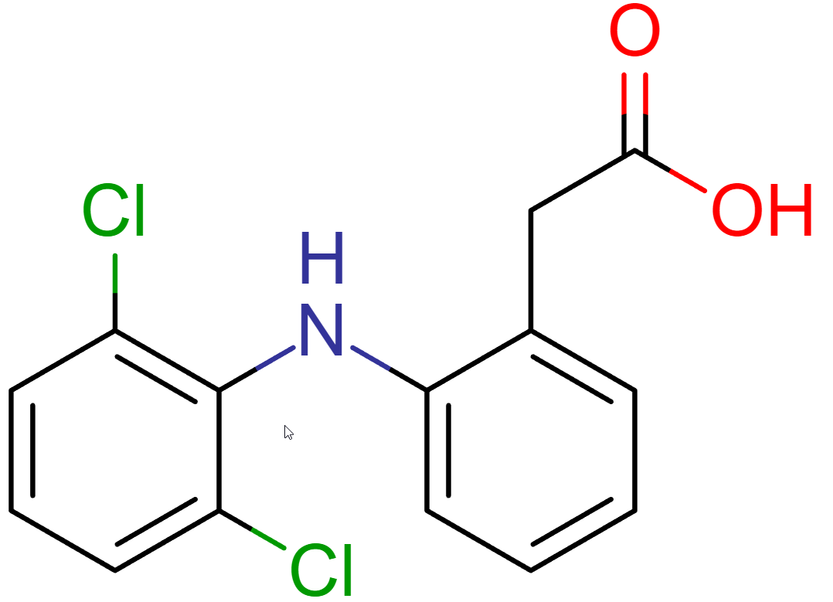
SAMPL8-5
Experimental pKa: 3.92
Combination | Solvent | Phase | Concentration (mg/mL) | Distribution Coefficient
1 | Octanol | Top | 0.013 | -0.5
 | BR Buffer pH 8 | Bottom | 0.039
2 | Cyclohexane | Top | 0.010 | -1.1
 | BR Buffer pH 8 | Bottom | 0.118
3 | Ethyl Acetate | Top | 0.084 | 0.1
 | BR Buffer pH 8 | Bottom | 0.063
4 | Heptane | Top | 0.009 | -1.2
 | BR Buffer pH 8 | Bottom | 0.151
5 | MEK | Top | 0.048 | -0.4
 | BR Buffer pH 8 | Bottom | 0.113
6 | TBME | Top | 0.087 | -0.0
 | BR Buffer pH 8 | Bottom | 0.092
7 | Cyclohexane | Top | 0.000 | Cannot compute
 | DMF | Bottom | 0.145

Slide 6
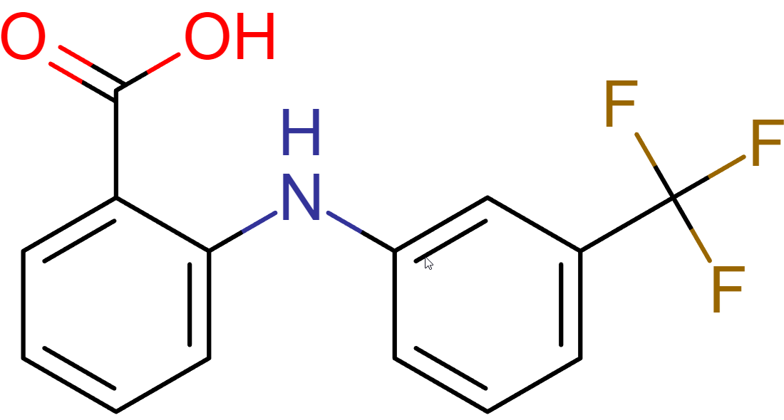
SAMPL8-1
Experimental pKa: 2.54, 5.01*
Combination | Solvent | Phase | Concentration (mg/mL) | Distribution Coefficient
1 | Octanol | Top | 0.175 | 0.8
 | BR Buffer pH 8 | Bottom | 0.030
2 | Cyclohexane | Top | 0.000 | Cannot compute
 | BR Buffer pH 8 | Bottom | 0.250
3 | Ethyl Acetate | Top | 0.096 | 0.3
 | BR Buffer pH 8 | Bottom | 0.051
4 | Heptane | Top | 0.163 | 0.0
 | BR Buffer pH 8 | Bottom | 0.158
5 | MEK | Top | 0.045 | -0.2
 | BR Buffer pH 8 | Bottom | 0.066
6 | TBME | Top | 0.066 | 0.1
 | BR Buffer pH 8 | Bottom | 0.055
7 | Cyclohexane | Top | 0.028 | -0.7
 | DMF | Bottom | 0.130

Slide 7
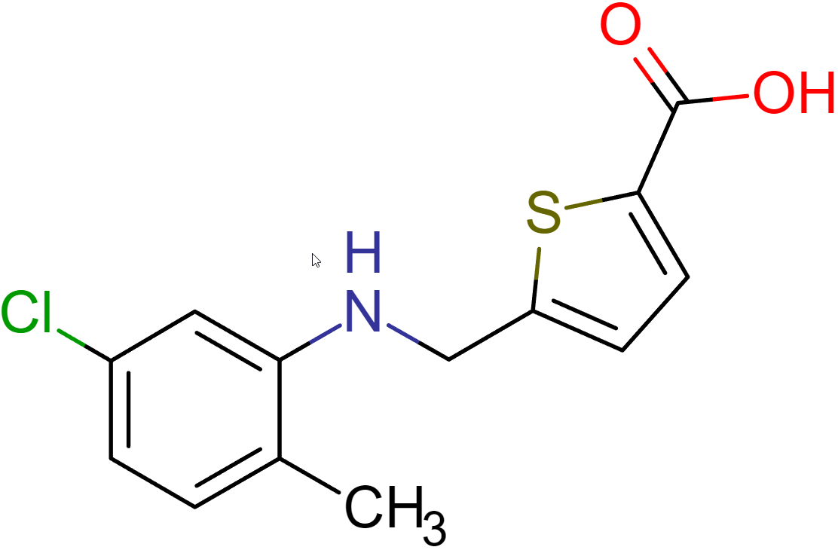
SAMPL8-6
Experimental pKa: 4.17
Combination | Solvent | Phase | Concentration (mg/mL) | Distribution Coefficient
1 | Octanol | Top | 0.035 | -0.4
 | BR Buffer pH 8 | Bottom | 0.083
2 | Cyclohexane | Top | 0.000 | Cannot compute
 | BR Buffer pH 8 | Bottom | 0.147
3 | Ethyl Acetate | Top | 0.071 | -0.1
 | BR Buffer pH 8 | Bottom | 0.091
4 | Heptane | Top | 0.000 | Cannot compute
 | BR Buffer pH 8 | Bottom | 0.159
5 | MEK | Top | 0.040 | -0.5
 | BR Buffer pH 8 | Bottom | 0.121
6 | TBME | Top | 0.067 | -0.2
 | BR Buffer pH 8 | Bottom | 0.107
7 | Cyclohexane | Top | 0.080 | 0.0
 | DMF | Bottom | 0.081

Slide 8
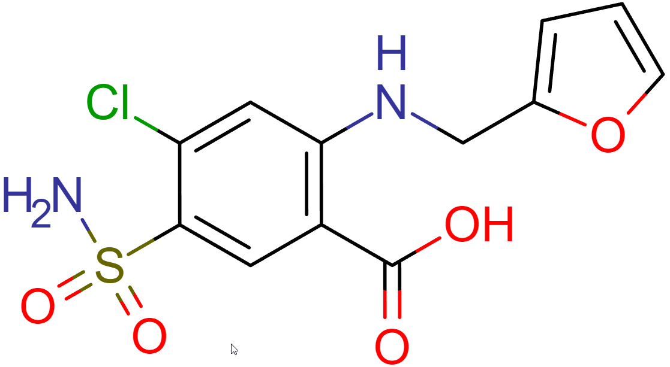
SAMPL8-3
Experimental pKa: 4.00
Combination | Solvent | Phase | Concentration (mg/mL) | Distribution Coefficient
1 | Octanol | Top | 0.000 | Cannot compute
 | BR Buffer pH 8 | Bottom | 0.130
2 | Cyclohexane | Top | 0.000 | Cannot compute
 | BR Buffer pH 8 | Bottom | 0.139
3 | Ethyl Acetate | Top | 0.022 | -0.8
 | BR Buffer pH 8 | Bottom | 0.125
4 | Heptane | Top | 0.000 | Cannot compute
 | BR Buffer pH 8 | Bottom | 0.090
5 | MEK | Top | 0.025 | -0.6
 | BR Buffer pH 8 | Bottom | 0.098
6 | TBME | Top | 0.000 | Cannot compute
 | BR Buffer pH 8 | Bottom | 0.115
7 | Cyclohexane | Top | 0.000 | Cannot compute
 | DMF | Bottom | 0.114

Slide 9
List of Completed pH Solubility Compounds
This is the completed list of compounds processed through Britton-Robinson pH solubility to determine pKa
 | SAMPL Set 2 SAMPL8-10 SAMPL8-7 SAMPL8-9 SAMPL8-12

Slide 10
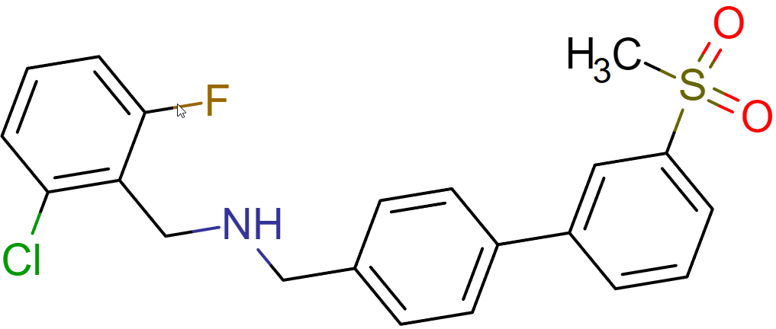
SAMPL8-10
Experimental pKa: 7.71
Combination | Solvent | Phase | Concentration (mg/mL) | Distribution Coefficient
1 | Octanol | Top | 0.034 | -0.6
 | BR Buffer pH 3 | Bottom | 0.131
2 | Cyclohexane | Top | 0.000 | Cannot compute
 | BR Buffer pH 3 | Bottom | 0.181
3 | Ethyl Acetate | Top | 0.096 | 0.1
 | BR Buffer pH 3 | Bottom | 0.074
4 | Heptane | Top | 0.016 | -1.0
 | BR Buffer pH 3 | Bottom | 0.169
5 | MEK | Top | 0.097 | 0.0
 | BR Buffer pH 3 | Bottom | 0.094
6 | TBME | Top | 0.020 | -0.9
 | BR Buffer pH 3 | Bottom | 0.142
7 | Cyclohexane | Top | 0.000 | Cannot compute
 | DMF | Bottom | 0.173

Slide 11
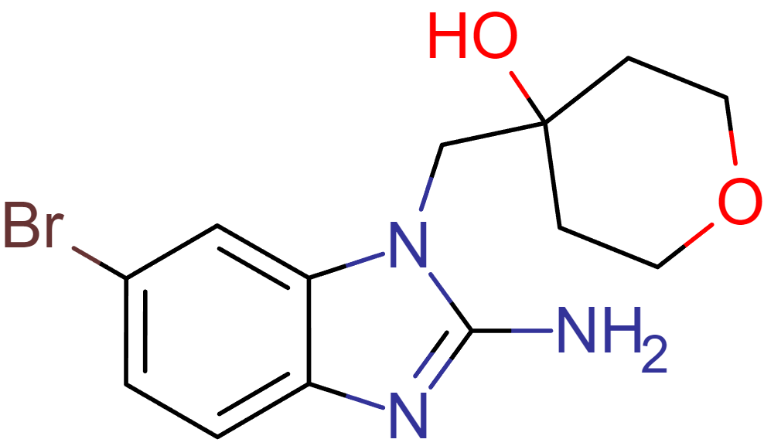
SAMPL8-7
Experimental pKa: 6.63
Combination | Solvent | Phase | Concentration (mg/mL) | Distribution Coefficient
1 | Octanol | Top | 0.008 | -1.3
 | BR Buffer pH 3 | Bottom | 0.154
2 | Cyclohexane | Top | 0.000 | Cannot compute
 | BR Buffer pH 3 | Bottom | 0.186
3 | Ethyl Acetate | Top | 0.000 | Cannot compute
 | BR Buffer pH 3 | Bottom | 0.184
4 | Heptane | Top | 0.000 | Cannot compute
 | BR Buffer pH 3 | Bottom | 0.179
5 | MEK | Top | 0.048 | -0.4
 | BR Buffer pH 3 | Bottom | 0.128
6 | TBME | Top | 0.000 | Cannot compute
 | BR Buffer pH 3 | Bottom | 0.179
7 | Cyclohexane | Top | 0.000 | Cannot compute
 | DMF | Bottom | 0.174

Slide 12
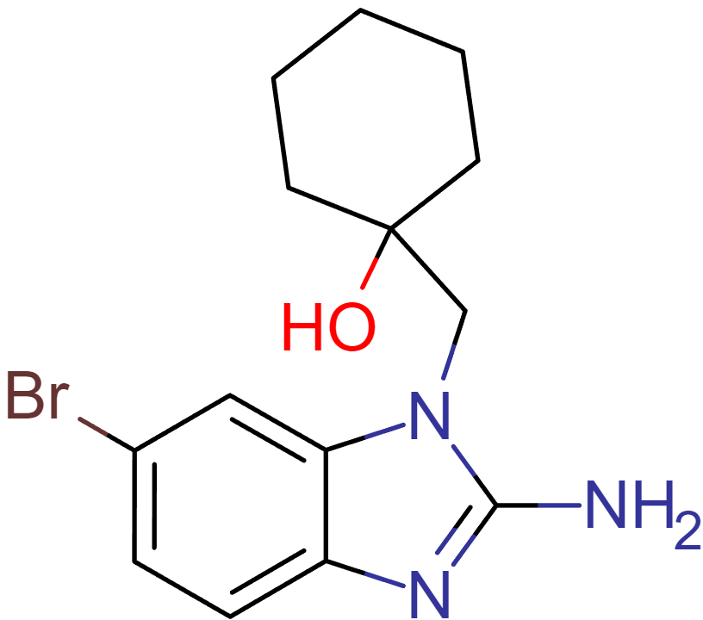
SAMPL8-9
Experimental pKa: 6.08
Combination | Solvent | Phase | Concentration (mg/mL) | Distribution Coefficient
1 | Octanol | Top | 0.046 | -0.1
 | BR Buffer pH 3 | Bottom | 0.060
2 | Cyclohexane | Top | 0.000 | Cannot compute
 | BR Buffer pH 3 | Bottom | 0.176
3 | Ethyl Acetate | Top | 0.019 | -0.8
 | BR Buffer pH 3 | Bottom | 0.124
4 | Heptane | Top | 0.000 | Cannot compute
 | BR Buffer pH 3 | Bottom | 0.181
5 | MEK | Top | 0.174 | 0.4
 | BR Buffer pH 3 | Bottom | 0.064
6 | TBME | Top | 0.000 | Cannot compute
 | BR Buffer pH 3 | Bottom | 0.184
7 | Cyclohexane | Top | 0.000 | Cannot compute
 | DMF | Bottom | 0.143

Slide 13
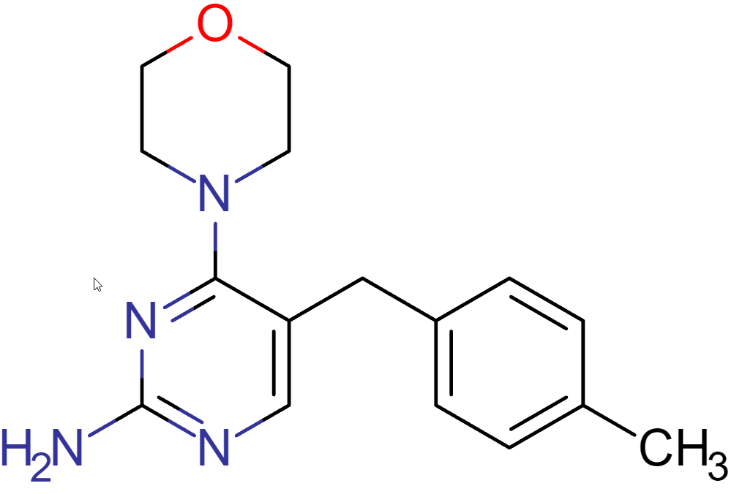
SAMPL8-12
Experimental pKa: 6.98
Combination | Solvent | Phase | Concentration (mg/mL) | Distribution Coefficient
1 | Octanol | Top | 0.030 | -0.7
 | BR Buffer pH 3 | Bottom | 0.159
2 | Cyclohexane | Top | 0.000 | Cannot compute
 | BR Buffer pH 3 | Bottom | 0.164
3 | Ethyl Acetate | Top | 0.006 | -1.4
 | BR Buffer pH 3 | Bottom | 0.145
4 | Heptane | Top | 0.000 | Cannot compute
 | BR Buffer pH 3 | Bottom | 0.154
5 | MEK | Top | 0.043 | -0.4
 | BR Buffer pH 3 | Bottom | 0.104
6 | TBME | Top | 0.000 | Cannot compute
 | BR Buffer pH 3 | Bottom | 0.162
7 | Cyclohexane | Top | 0.000 | Cannot compute
 | DMF | Bottom | 0.164

Slide 14
List of Completed pH Solubility Compounds
This is the completed list of compounds processed through Britton-Robinson pH solubility to determine pKa
 |  | SAMPL Set 3 SAMPL8-17 SAMPL8-16 SAMPL8-14

Slide 15
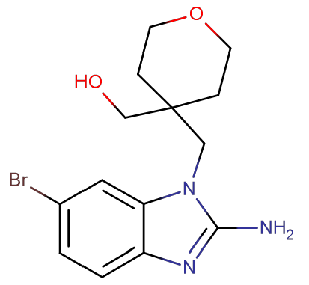
SAMPL8-17
Experimental pKa: 6.58
Combination | Solvent | Phase | Concentration (mg/mL) | Distribution Coefficient
1 | Octanol | Top | 0.000 | Cannot compute
 | BR Buffer pH 3 | Bottom | 0.129
2 | Cyclohexane | Top | 0.000 | Cannot compute
 | BR Buffer pH 3 | Bottom | 0.153
3 | Ethyl Acetate | Top | 0.006 | -1.4
 | BR Buffer pH 3 | Bottom | 0.168
4 | Heptane | Top | 0.000 | Cannot compute
 | BR Buffer pH 3 | Bottom | 0.168
5 | MEK | Top | 0.022 | -0.8
 | BR Buffer pH 3 | Bottom | 0.145
6 | TBME | Top | 0.000 | Cannot compute
 | BR Buffer pH 3 | Bottom | 0.176
7 | Cyclohexane | Top | 0.000 | Cannot compute
 | DMF | Bottom | 0.157

Slide 16
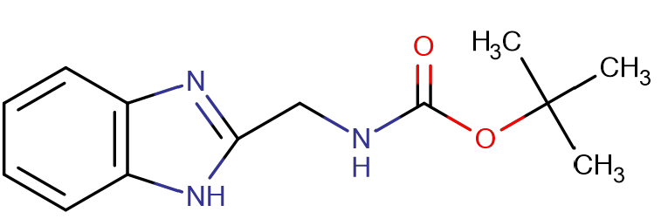
SAMPL8-16
Experimental pKa: 5.10
Combination | Solvent | Phase | Concentration (mg/mL) | Distribution Coefficient
1 | Octanol | Top | 0.034 | -0.4
 | BR Buffer pH 3 | Bottom | 0.089
2 | Cyclohexane | Top | 0.000 | Cannot compute
 | BR Buffer pH 3 | Bottom | 0.167
3 | Ethyl Acetate | Top | 0.032 | -0.5
 | BR Buffer pH 3 | Bottom | 0.105
4 | Heptane | Top | 0.016 | -1.0
 | BR Buffer pH 3 | Bottom | 0.158
5 | MEK | Top | 0.070 | -0.3
 | BR Buffer pH 3 | Bottom | 0.126
6 | TBME | Top | 0.009 | -1.2
 | BR Buffer pH 3 | Bottom | 0.131
7 | Cyclohexane | Top | 0.008 | -1.3
 | DMF | Bottom | 0.154

Slide 17
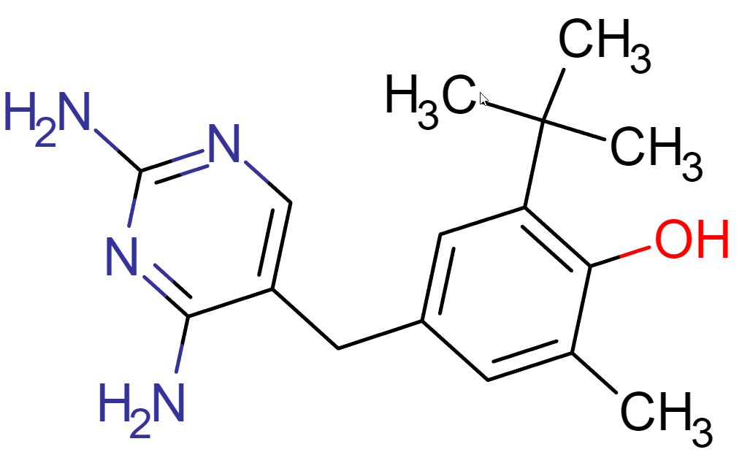
SAMPL8-14
Experimental pKa: 7.27
Combination | Solvent | Phase | Concentration (mg/mL) | Distribution Coefficient
1 | Octanol | Top | 0.012 | -1.0
 | BR Buffer pH 3 | Bottom | 0.115
2 | Cyclohexane | Top | 0.000 | Cannot Compute
 | BR Buffer pH 3 | Bottom | 0.248
3 | Ethyl Acetate | Top | 0.026 | -0.8
 | BR Buffer pH 3 | Bottom | 0.172
4 | Heptane | Top | 0.000 | Cannot Compute
 | BR Buffer pH 3 | Bottom | 0.222
5 | MEK | Top | 0.161 | 0.1
 | BR Buffer pH 3 | Bottom | 0.119
6 | TBME | Top | 0.000 | Cannot compute
 | BR Buffer pH 3 | Bottom | 0.203
7 | Cyclohexane | Top | 0.000 | Cannot compute
 | DMF | Bottom | 0.117

